Slide 1
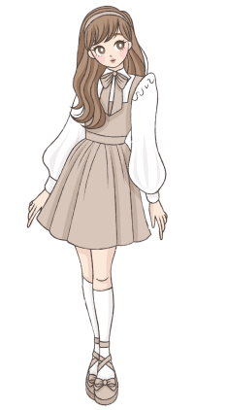


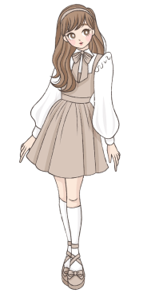
27
“Peepo”
girls
boys
27 girls in box named girls and Peepo in box named boys

Slide 2





98
95
boys
girls
Replaced ‘Peepo’ with 98 boys
(it will have consequences)
Changed mind , added 95 no of girls

Slide 3
boys
Boys
Or
gentlemen
gentlemen
gentlemen
boys
15
15
Then!
When I say gentlemen = boys in the code, the box boys gets a new name which is gentlemen. And if I ask by using either of the names, I will get the same box. If I change gentlemen it will mean that boys is changed

Slide 4

95
15
girls
Boys
Or
gentlemen

Slide 5


Add no of girls and boys or value of these boxes and give me total number
Print(girls + boys)
OK
Boys
Or
gentlemen
girls
110
(girls+boys)
95 (girls)
15 (boys)

